Slide 1
Data 101 Final Project
By Arnav Dashaputra
Notes:
Eco 2071, 1870, 1722, 1984, 1901, 2004, 2427, 2521, 1521, 1990, 1491, 2041, 1251, 3121, 1429, 1049, 2141, 2111, 2666, 2233
Farmer 4142, 1213, 1401, 2104, 2140, 2112, 1292, 1211, 2330, 2520, 2852, 1204, 1211, 2591, 1219, 1569, 2591, 2582, 2150, 2151

Slide 2
Preface
Minecraft. One of Minecraft’s best features is the ability for people to host their own game servers. Whether this be friends connecting to each other, or companies renting server hardware to host for thousands of players, multiplayer Minecraft has been around since the game’s creation.
Hypixel is and has been the largest third party server. Based in Canada, Hypixel generates millions of dollars of revenue yearly, and often have over 100,000 concurrent players.
One of the attractions of Hypixel is that they offer a wide variety of custom-coded games. One such game is called Skywars. Skywars is a popular competitive game in which, 12 players fight it out to be the last one standing. However, this does not take the ordinary Hunger Games approach - each player starts out on a floating island with limited resources, and have the option to travel to the middle of the game where lies a large island. This large island contains far better resources than the starting islands. Additionally, each player gets some starting items, called a “kit”. Each kit contains different items and players can only choose one kit at a time before a game starts.

Slide 3
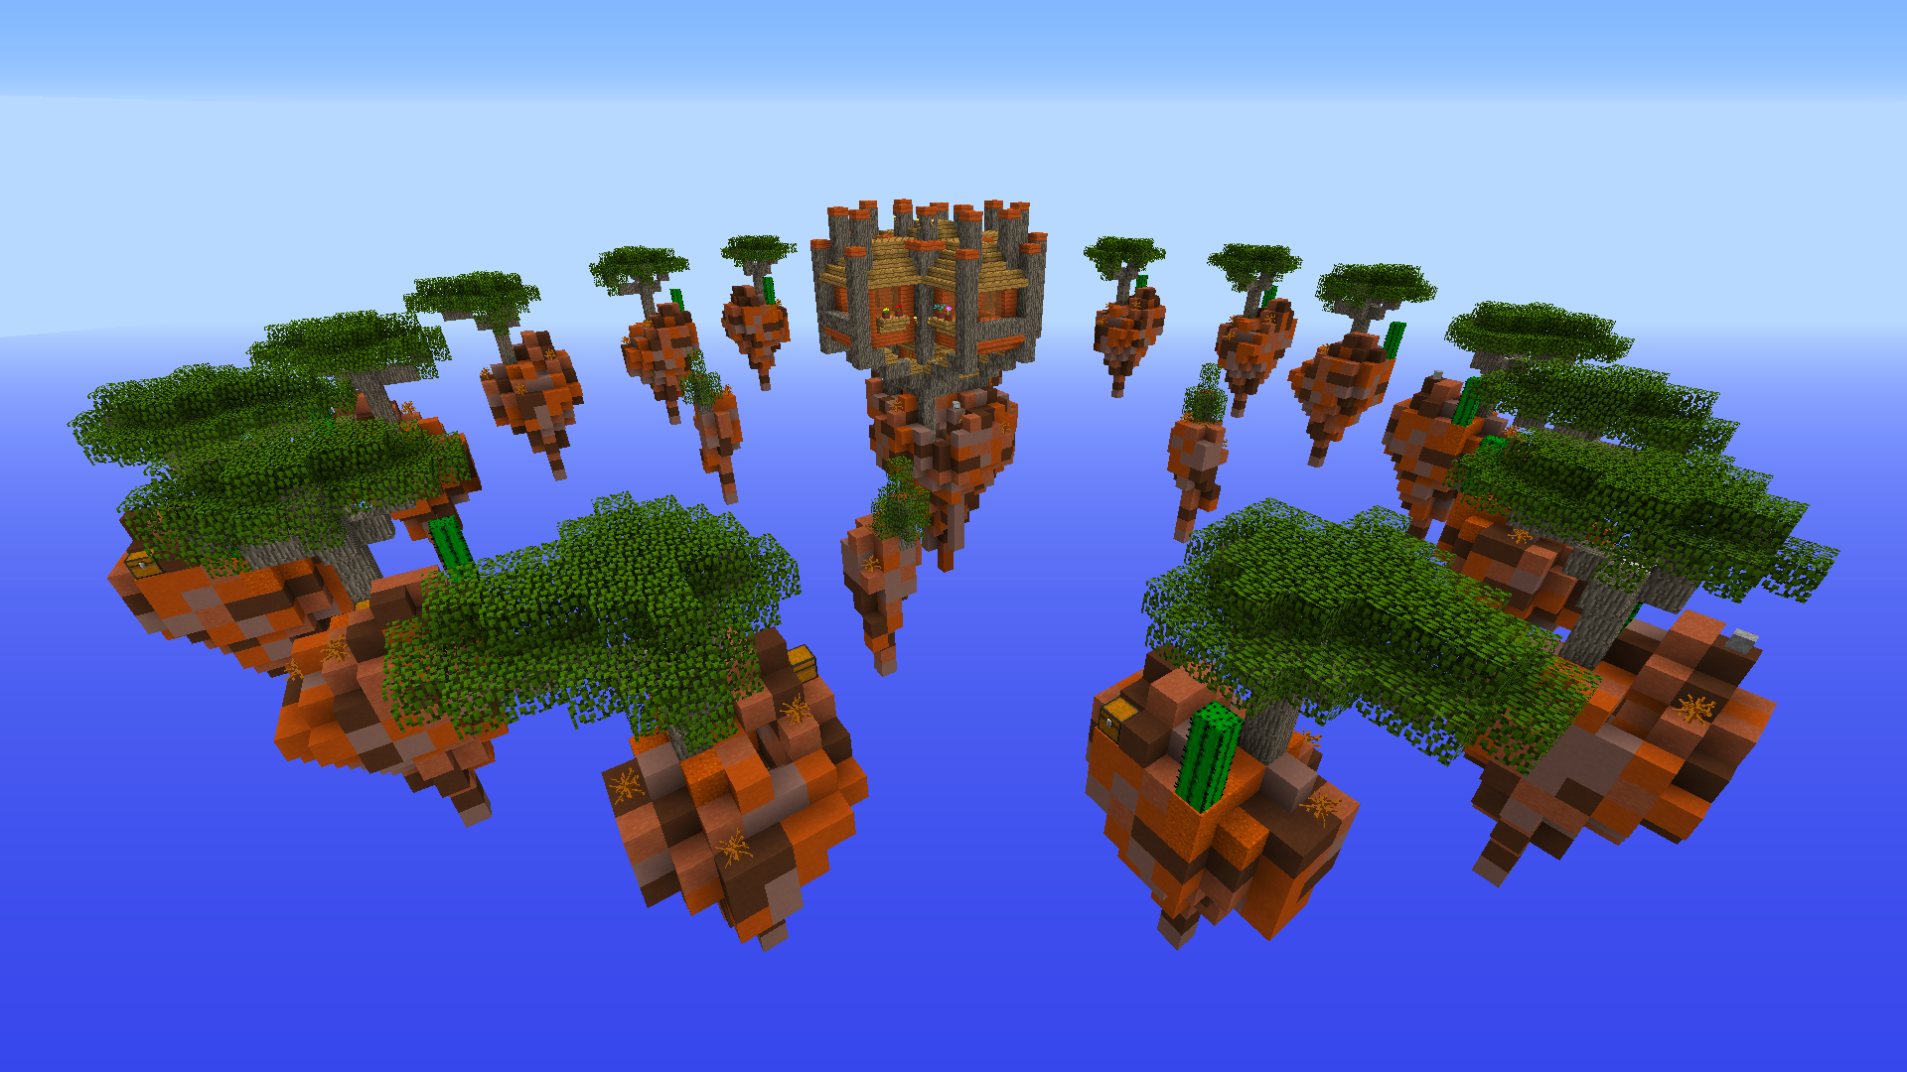
An example of a skywars game, with small islands surrounding one large island.
Players can place blocks found on their starting island to bridge out to the larger island.
However, players can also knock other players off their bridges, resulting in killing them.

Slide 4
Does a game’s kit affect win rate?
While I was playing, I saw how much my kit mattered in winning the game. Since getting to the middle fast can help in winning a game, I personally choose kits that help me get to the middle. “Ecologist” and “farmer” are good kits for this. Ecologist lets you collect items very fast, which lets you get to the middle faster. However, Farmer is safer since it allows you to stop anyone from killing you before getting to the middle. I believed that since getting to the middle fast is more important than anything else, that ecologist was the best kit to use.
Thankfully for data science, Hypixel collects a ton of user data and on each and every game played. Using this data, one can see their most popular kit, and how many wins and losses they have with it. I collected the statistics (which are public, using the Hypixel Public API) of me and a lot of my friends to see whether or not kits give a large enough win advantage.
Note: The Hypixel public API requires an API key to be generated through the use of an in-game command, thus paywalling the API behind a Minecraft account.

Slide 5
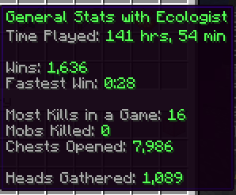
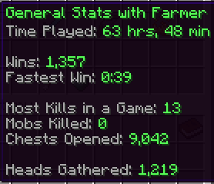
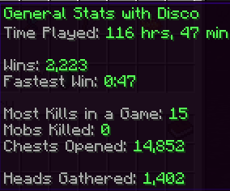
Example Statistics
My own statistics using the Ecologist kit
A friend’s statistics using the Farmer kit
Another friend’s statistics
using the Disco kit,
as an example.
credits: lovelyhappy

Slide 6


Since winning is important...
I have decided to simplify the process in only choosing the two kits that would matter in gameplay: ecologist and farmer. Since my personal strategy is to get to the middle fastest, these kits allow me to do so. I would like to know whether the Ecologist kit results in more wins (for everyone, not only me), than the Farmer kit.
My hypothesis is that one of these kits do matter in winning a game. My prediction is that the ecologist kit is better, since it allows getting to the middle faster.
The null hypothesis is that the kit used by a player does not matter in an eventual win, or will not help dictate whether the game will be a win or a loss.
starting blocks let you
quickly get to the middle
eggs can be thrown to knock
other players away
Ecologist Kit
Farmer Kit

Slide 7
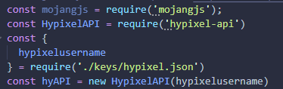

Data Collection
I decided to write a script in Node.JS (javascript) to collect all of the data values I needed for testing my hypothesis. I started off with using the mojangjs API to collect username and player UUID (identification tags). I then got a wrapper for the Hypixel Public API developed for javascript called hyAPI. This will help me scrape data from Hypixel’s end.
Next, I began data collection. To simplify the process, I created a json file filled with the usernames of people I wanted to collect the data of. I then utilized the API to feed me the appropriate data, e.g. their total wins, and games played. To find the specific API endpoints I needed to reach, I queried a large promise (a proxy for a value not necessarily known when the promise object was created), and scanned through it to find the information I needed. I then saved these in variables and added them to a counter at the end.

Slide 8
Statistical Work
Using my script, here is the data that I ended up with. I added these to an R data frame to easier manipulate my data.
Total games (any kit): 92,240
Total ecologist games: 39,544
Total farmer games: 40,585
Total ecologist wins: 16,737
Total farmer wins: 18,234
Average ecologist wins: 16,737 / total players = 836.85
Average farmer wins: 18,234 / total players = 911.70
R work
wins = data.frame(ecologist, farmer)
totalEco = sum(wins$ecologist)
totalFarm = sum(wins$farmer)
avgEcoWin = 16737 / nrow(wins)
avgFarmWin = 18234 / nrow(wins)

Slide 9
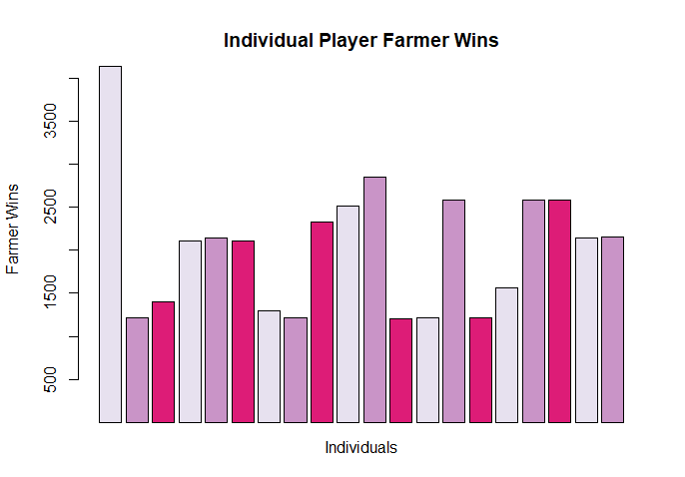
Outliers
Based on this visualization, I noticed that there could be an outlier in my data. To find if this was an outlier, I tested if the leftmost value seen (4,142 wins) is more than 1.5 times away from either the lower or upper quartiles.
The z score I got for this value ended up being 2.78, giving me a p value less than 0.05. Additionally, 2.78 is above the critical value of the z score which is 2.71. This was indeed a statistical outlier, and I replaced it with better fitting data.
R code:
# to omit the value and later replace it:
winsNew = wins[-c(1),]
outlier!

Slide 10
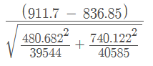
Statistical Work Continued
R Code
sd.Eco = sd(wins$ecologist)
sd.Farm = sd(wins$farmer)
zScore =
pValue = 1 - pnorm(17.020)
# for visualizations:
install.packages("RColorBrewer")
library(RcolorBrewer)
Next, I found the standard deviations of the win rates of both kits.
Standard deviation ecologist: 493.1694
Standard deviation farmer: 759.3494
Z score: 17.020
P value: 0

Slide 11
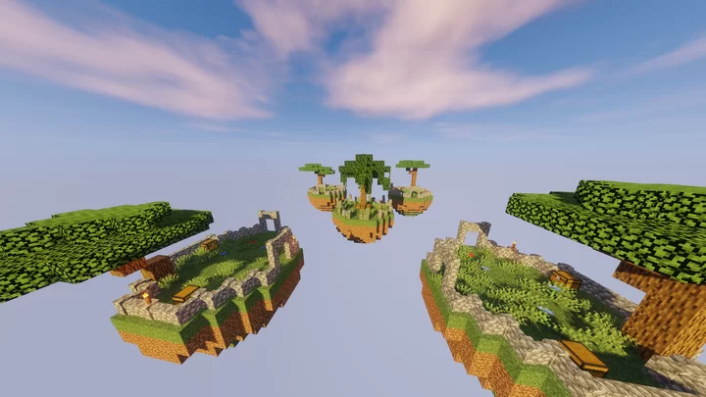
Statistical Analysis
The p value of 0 is less than 0.05, the significance level indicating that there is a 5% risk of falsely rejecting the null hypothesis. Therefore, the null hypothesis should be rejected, and there is a significant difference in what kit is used to start a game.

Slide 12
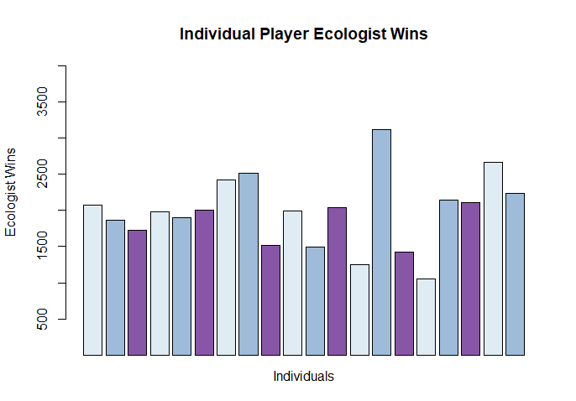
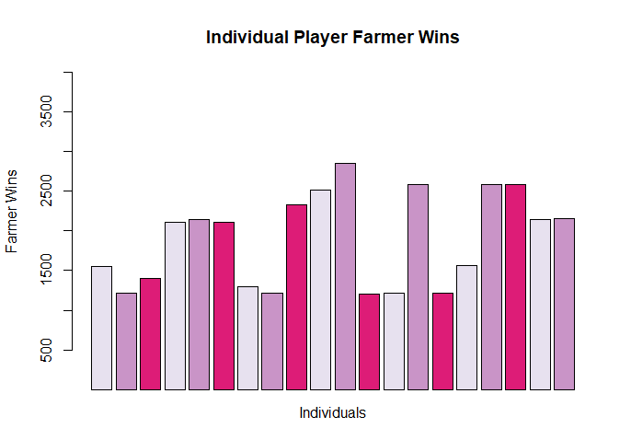
Visualizations
As seen, there are more farmer wins compared to ecologist wins.
barplot(wins$ecologist, ylim=c(500,4000), xlab="Individuals", ylab="Ecologist Wins", main="Individual Player Ecologist Wins", col = brewer.pal(n = 3, name = "BuPu"))
barplot(wins$farmer, ylim=c(500,4000), xlab="Individuals", ylab="Farmer Wins", main="Individual Player Farmer Wins", col = brewer.pal(n = 3, name = "PuRd"))

Slide 13

Conclusion
In short, given that the players are utilizing the best winning play style (rushing to the middle), the kit that is used does matter in winning a game. Although the ecologist kit results in getting to the middle faster, using the Farmer kit and taking more time to get to the middle safer is ultimately more worth it.

Slide 14
Sources
NodeJS - https://nodejs.org/en/
Hypixel - https://hypixel.net/
Hypixel Public API - https://api.hypixel.net/
Hypixel-api - https://www.npmjs.com/package/hypixel-api
Mojangjs - https://www.npmjs.com/package/mojangjs
VS Code - https://code.visualstudio.com/
Atom One Dark - https://marketplace.visualstudio.com/items?itemName=akamud.vscode-theme-onedark
Happy Steve Picture - https://www.fiverr.com/kingdom275/have-steve-say-happy-birthday
Skywars Map 1 Picture - https://www.cubecraft.net/threads/skywars-map-mesa.7200/
Skywars Map 2 Picture - https://www.planetminecraft.com/project/1-16-1-skywars-map-4-islands/
Scientific Calculator - https://www.symbolab.com/

